Slide 1
Error Handling In C#
G.Affleck

Slide 2
Error Handling
Error Types:
Syntax Errors
Runtime Errors
Logic Errors

Slide 3
Syntax Errors

Slide 4
Syntax Errors
These are a violation of the grammatical rules of the language

Slide 5
Syntax Errors
These are a violation of the grammatical rules of the language
The compiler will pick them up and report them to you

Slide 6
Syntax Errors
These are a violation of the grammatical rules of the language
The compiler will pick them up and report them to you
Syntax errors therefore tend to be the easiest to correct

Slide 7
Syntax Errors
Syntax errors are errors in the written code that the C# compiler will find i.e. incorrectly structured coding.
Examples :
1. Misspelled data type
2. Duplicate identifier names
3. Misspelled identifier name

Slide 8
Syntax Errors
Incorrect Structure Of Selection
Or Looping Constructs
Incorrect structure of Selection or Looping Constructs
Incorrect structure of functions, classes
Any other incorrect coding structure

Slide 9
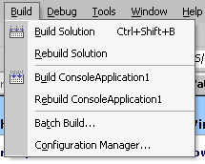
Finding Syntax Errors: Use the Compiler
If you select ‘Build Solution’ syntactical errors will be picked up and you will be able to debug.

Slide 10
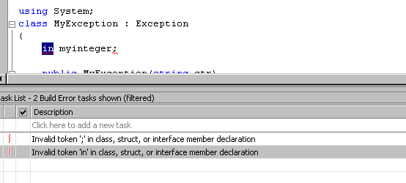
1. Misspelled data type

Slide 11
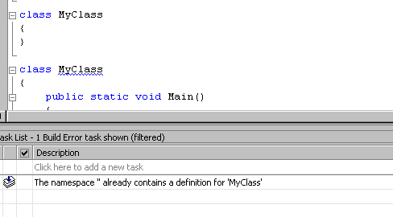
Duplicate Identifier Names

Slide 12

Syntax errors
The best way to eliminate bugs is to prevent them in the first place.
  The syntax checker looks for errors or missing items in a statement, such as a parentheses or a keyword and this will be signified with red underline
For example a missing semi-colon:

Slide 13
Syntax errors
  syntax checker automatically displays keywords in blue
    this gives a visual indication that you have correctly entered a
      command
      keyword
      property
    prevents ‘typos’

Slide 14
Run-Time Errors

Slide 15
Run -time errors
When a program is syntactically correct it will be compiled into machine code correctly

Slide 16
Run -time errors
When a program is syntactically correct it will be compiled into machine code correctly
but when you run the code it may the crash (i.e. stop running abruptly).

Slide 17
Run -time errors
When a program is syntactically correct it will be compiled into machine code correctly
but when you run the code it may the crash (i.e. stop running abruptly).
This is due to a Run-Time Error

Slide 18
Run -time errors
When a program is syntactically correct it will be compiled into machine code correctly
but when you run the code it may the crash (i.e. stop running abruptly).
This is due to a Run-Time Error
The computer is unable to implement a syntactically correct statement due to some values of the variables involved e.g.

Slide 19
Example of Run-Time Errors
Trying to divide by 0

Slide 20
Example of Run-Time Errors
Trying to divide by 0
Computing numerical values which are beyond the maximum value the machine can hold

Slide 21
Example of Run-Time Errors
Trying to divide by 0
Computing numerical values which are beyond the maximum value the machine can hold
Using an index for an array which is outside the prescribed index range

Slide 22
Example of Run-Time Errors
Trying to divide by 0
Computing numerical values which are beyond the maximum value the machine can hold
Using an index for an array which is outside the prescribed index range
Using a value for an expression which does not correspond to a valid value.

Slide 23
Run Time Errors
Runtime errors cause a program to crash
A runtime error is therefore an unexpected event that happens while your program is running and can’t be recovered from.
The error occurs anytime a statement executes that for some reason cannot be completed.
We need to tell the compiler what to do when something goes wrong. We need to write error handlers.

Slide 24
Processing errors using Error Handlers
You can use error handlers in any situation in which an unexpected action may result in an error.
Examples:
Network problems
Disk problems
Printer off-line
Overflow errors
Out-of memory errors

Slide 25
Try…catch Statement
The try…catch statement is used on a block of code you are worried about.
The try…catch statement sets a trap for the error, catching the error.
and
finally : this statement will always execute.

Slide 26
using System;
class MyClass
{
public static void Main()
{
int A = 0;
int div = 100/A;
Console.WriteLine(div);
}
}

Slide 27
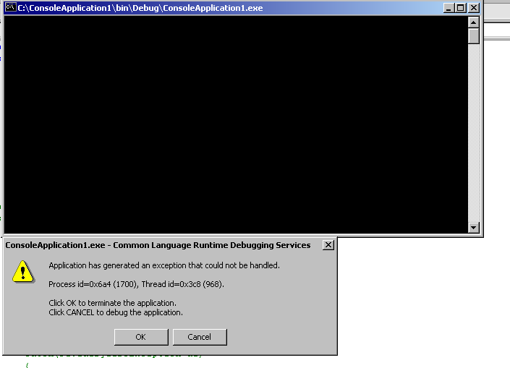
This error has not been handled.

Slide 28
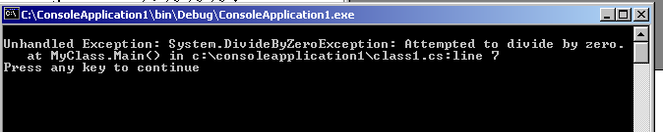
An results in a non-eleganr end to the program run.

Slide 29
public static void Main()
{
int A = 0;
int div = 0;
try
{
div = 100/A;
Console.WriteLine("This line will not execute");
}
catch(DivideByZeroException de)
{
Console.WriteLine("Exception occured");
}
Console.WriteLine("Result is {0}",div);
}
An example of handling an error using try..catch .

Slide 30
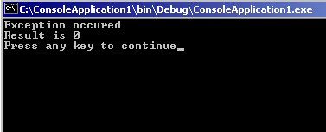
The result is that the error is handled more gracefully.

Slide 31
public static void Main()
{ int A = 0;
int div = 0;
try
{ div = 100/A;
Console.WriteLine("This line will not execute");
}
catch(DivideByZeroException e)
{
Console.WriteLine("Exception occured");
}
finally
{ Console.WriteLine("Finally Block");
}
Console.WriteLine("Result is {0}",div);}
The finally block will also execute after the try…catch.

Slide 32
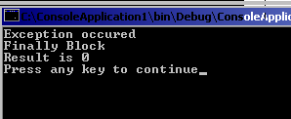
The result would be:

Slide 33
Multiple Catch Blocks
try
{
div = 100/A;
Console.WriteLine("This line will not execute");
}
catch
{
Console.WriteLine("Exception occured");
}
finally ….
General:

Slide 34
Multiple Catch Blocks
try
{
div = 100/A;
Console.WriteLine("This line will not execute");
}
catch
{
Console.WriteLine("Exception occured");
}
finally ….
General:
Note: the parameter is optional
Catch (Exception e)

Slide 35
try
{
div = 100/A;
Console.WriteLine("This line will not execute");
catch(DivideByZeroException de)
{
Console.WriteLine("DivideByZeroException" );
}
catch
{
Console.WriteLine("Exception occured");
}
finally ….
specialised
general

Slide 36
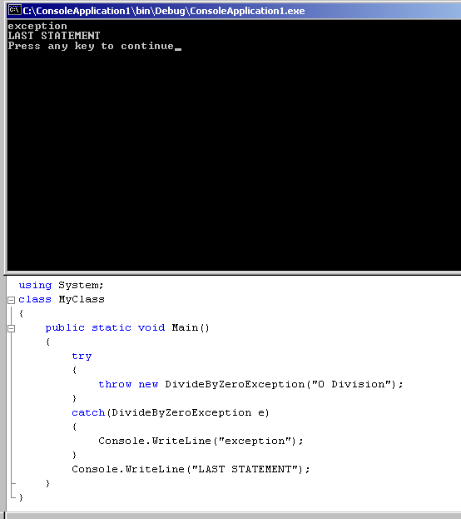
Throwing an exception

Slide 37
Re-Throwing to a higher context:
class MyClass2
{ public static void Main()
{
MyClass gn = new MyClass();
try
{
gn.initial();
}
catch(Exception e)
{
Console.WriteLine("Exception caught here" );
}
Console.WriteLine("LAST STATEMENT");
}
}
using System;
class MyClass
{
public void initial()
{
try
{int A = 0;
int sum = 10/A;
}
catch(DivideByZeroException e)
{
throw;
}
}

Slide 38
User- Defined Exceptions:
using System;
class MyException : Exception
{
public MyException(string str)
{
Console.WriteLine("defined exception");
}
}

Slide 39
class MyClient
{
public static void Main()
{
try
{
throw new MyException(“unique");
}
catch(Exception e)
{
Console.WriteLine("Exception caught here" + e)
}
Console.WriteLine("LAST STATEMENT");
}
}

Slide 40
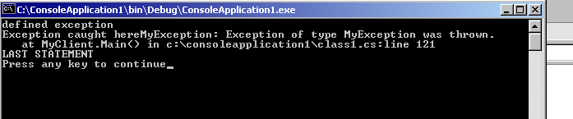
The output would be:

Slide 41
Logic Errors

Slide 42
Logic Errors
By far the most difficult errors to locate are the errors of logic

Slide 43
Logic Errors
By far the most difficult errors to locate are the errors of logic
These are also known as semantic errors

Slide 44
Logic Errors
By far the most difficult errors to locate are the errors of logic
These are also known as semantic errors
They occur either when the program does not solve the posed program correctly

Slide 45
Logic Errors
By far the most difficult errors to locate are the errors of logic
These are also known as semantic errors
They occur either when the program does not solve the posed program correctly
or when errors are made in coding a correct design.

Slide 46
Logic Errors Summary
Logic errors occur when the code compiles and runs successfully but the results expected are not gained.

Slide 47
Strategies For Finding Errors
Hand tracing of a program
Try following the code line by line
Get the computer to do this for us (at least in part)
Using debug facilities

Slide 48
Hand tracing of a program and the logical flow
Use a print - out of the program
starting at the beginning
keeping track of the values of the variables
the control flows as each statement would be executed.

Slide 49
Alternatively, place some print statements strategically and write out values of such as the variables
when you reach certain points in the programs structure
This will allow us to test at certain points whether the variables are taking the values we expect

Slide 50
Use de-bug facilities:
There is a menu option that allows us to trace through a program
Using this we can execute one statement, or function at a time, or set breakpoints.

Slide 51
The Debugging tools

Slide 52
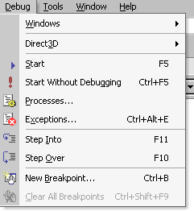

Slide 53
Debugging
To test and debug an application, you need to understand which mode you are in at any given time.

Slide 54
Debugging
1. Design time - most of the work of creating an application is done at design time
  Cannot execute code or use debugging tools, except for setting breakpoints and creating watch expressions
2. Run time - interacting with the application
the same way a user would.

Slide 55
Both design time and run time modes have their limitations
  in design time, you can change the design or code of an application, but you cannot see how your changes affect the way the application runs.
  in run time, you can watch how the application behaves, but you cannot directly change the code.

Slide 56
Debugging tools
Breakpoint
  defines a line in the Code window where execution of the application is suspended in break mode.
i.e. the code will run to the statement where the breakpoint is set.

Slide 57

To set a breakpoint
Double Click on the line that you want to set the breakpoint
To take the breakpoint off simply click here again.

Slide 58
Step Into
  executes the next executable line of code in the application and steps into functions.
Step Over
  executes the next executable line of code in the application without stepping into functions.

Slide 59
Watch expressions
As the application is debugged, a calculation may not produce the result intended or problems might occur when a certain variable or property assumes a particular value or range of values
    many debugging problems aren’t immediately traceable to a single statement, so you may need to observe the behaviour of a variable or expression throughout a procedure

Slide 60
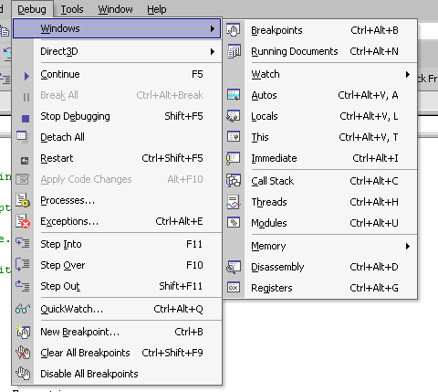
The watch window is available when running in break mode:

Slide 61
Restricting access
There are 3 approaches to preventing errors occurring
1. Error handling code should be included in the functions
2. Control the user’s access to specific functions i.e. public,private access.
3. Validate data during data input

Slide 62
Validating access
There will be some point in the program where the user must enter information
    to prevent any additional likelihood of errors, it is a good idea to check the information that is entered before it is processed by the program
    this process is known as validating data

Slide 63
Validating access
2 questions that need to be addressed are
Is the data in the correct range of values?
Did the user enter the right type of data?

